Slide 1
Employee Data Analysis using Excel
STUDENT NAME: MALINI V
REGISTER NO: 312219614 (asunm1715cc1221715024)
DEPARTMENT: 3 B.Com general
COLLEGE : Thalapathy k vinayakam women's arts and science college . Thiruttani

Slide 2
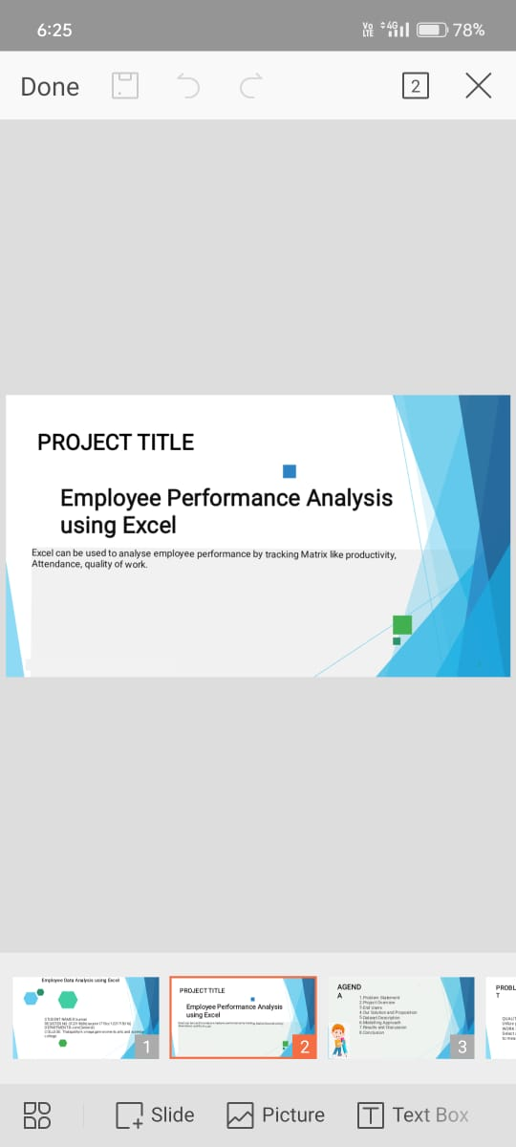
PROJECT TITLE
Employee Performance Analysis using Excel

Slide 3


AGENDA
Problem Statement
Project Overview
End Users
Our Solution and Proposition
Dataset Description
Modelling Approach
Results and Discussion
Conclusion
3/21/2024 Annual Review

Slide 4
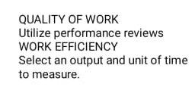

PROBLEM STATEMENT

Slide 5
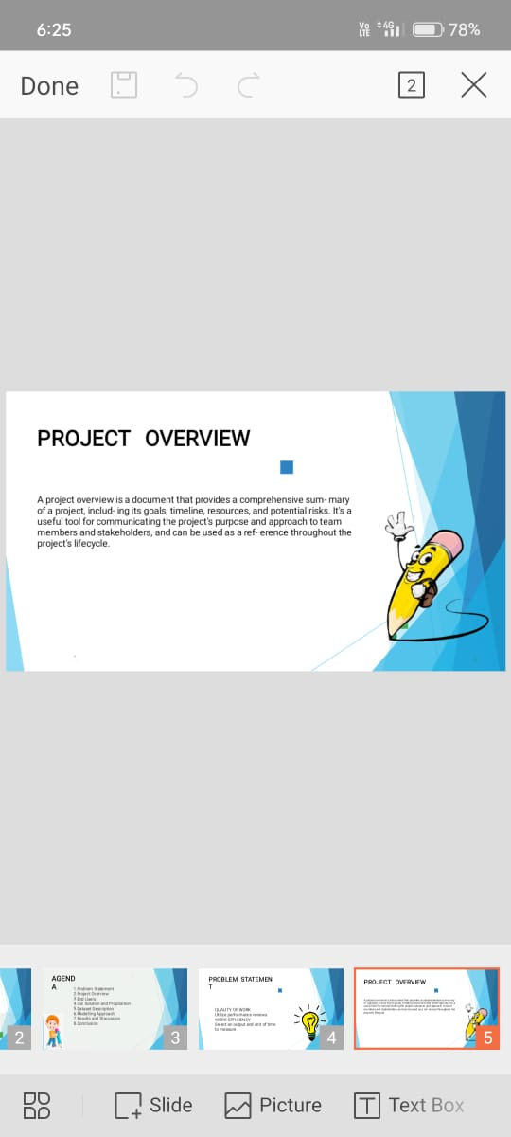

PROJECT OVERVIEW
.

Slide 6
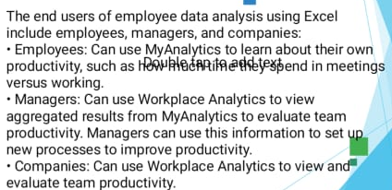

WHO ARE THE END USERS?

Slide 7

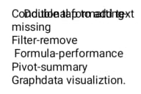
OUR SOLUTION AND ITS VALUE PROPOSITION

Slide 8
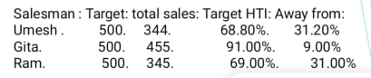
Dataset Description

Slide 9
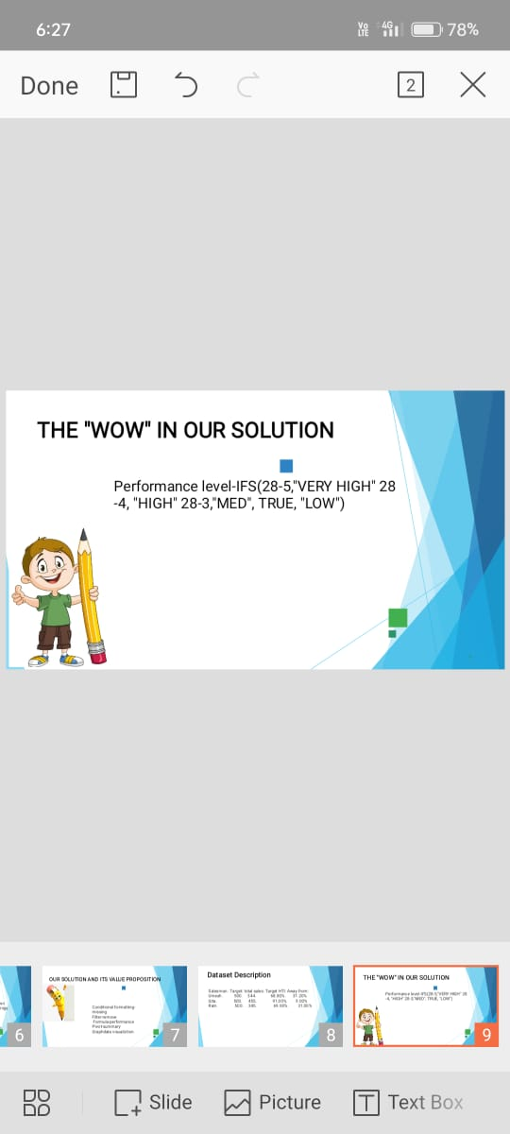

THE "WOW" IN OUR SOLUTION
3/21/2024 Annual Review
9

Slide 10
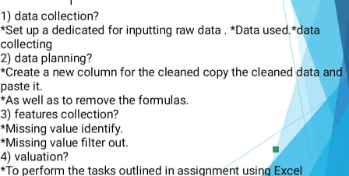
MODELLING
10

Slide 11
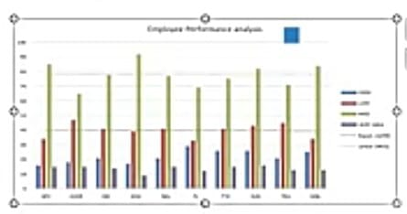
RESULTS
11

Slide 12

conclusion

